Slide 1
Improved Prediction of Protein-Protein binding sites using SVM
01
Presented by
Balaji Paiyur Mohan 1001576836
Kevin Thomas
1001544593

Slide 2
02
BIOINFORMATICS PAPER
 The authors of this paper are James R. Bradford and David R. Westhead, research scholars at the School of Biochemistry and Molecular Biology, University of Leeds, UK

Slide 3
Contents
03
 Keywords
 Understanding Proteins, their Structure, Interactions and Patches
 Purpose of Paper
 Dataset that is used
 Surface generation and interface definitions
 Properties of Protein Patches
 Why SVMs?
 What is a SVM and how does it work?
 Experimental set-up and Methodology
 Validation and Results
 References

Slide 4
TERMINOLOGIES USED
04
 Complexes
 Transient Interfaces
 Obligate Interfaces
 Docking Algorithms
 Residues
 Resolution of a Protein (higher resolution)

Slide 5
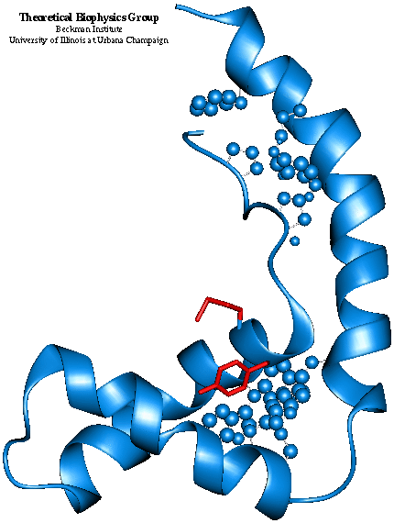
What are Proteins?
05
Complex Amino-acids that fold into a highly stable spherical structure
Structure, function, and regulation of the body’s tissues and organs

Slide 6
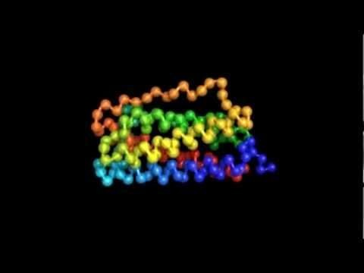
Protein Structure
06

Slide 7
How does Protein Interact?
07
 Proteins often form temporary bonds with each other called Protein-Protein Interactions
 Protein interactions are responsible for most processes in your body
Signal Transduction
Transport Across Membranes
Cell Metabolism
Muscle Contraction
 Protein surfaces can be split into 'patches'.
 These patches can either be interacting or non-interacting.

Slide 8
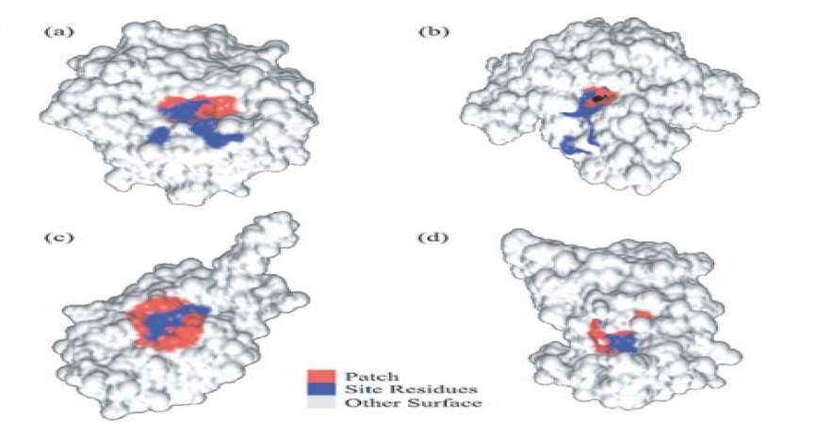
PROTEIN PATCHES
08

Slide 9
Purpose of the Paper
09
 Multiple protein-protein structures are produced, with unknown functions
 By identifying interacting surfaces, important clues to the function of proteins can be determined
 Each binding site shares important properties, which differentiate them from the rest of the protein
 However, no single property can do an absolute distinction
 Multiple such physical-chemical properties are combined for this purpose
 The authors have applied Support Vector Machines to predict these binding sites

Slide 10
Dataset THAT IS USED
10
 The authors manually produced their own high-quality, non-redundant dataset.
 A comprehensive set of complexes was chosen from the Protein Data Bank.
 They were subject to a number of stringent filters such as the following:
Proteins sharing >20% surface identity with higher resolution proteins were eliminated
Interfaces that were a result of crystal packing were eliminated only retaining dimers
Dimers containing <20% residue were eliminated
 A total of 180 proteins taken from 149 complexes survived the filtering process.
 Of the 180, 36 were involved in enzyme inhibitor interactions, 27 in hetero-obligate interactions, 87 in homo-obligate interactions and 30 in non-enzyme inhibitor transient interactions.

Slide 11
Surface Generation & Interface Definition
11
 All protein surfaces used were solvent excluded surfaces
 An atom became a part of the surface if it lost >99% of its surface in complex
formation
 Surface Patch Generation – The radius of the sphere needed to produce the patch is calculated and is placed on the center of the surface vector chosen to be the center of the patch
 Due to irregular topography of the protein surface, a large surface connected by
several small surfaces is generated. Only the largest one is retained.
 Patch Size - The size of the patch is determined by the size of the interacting proteins in the complex and the size of the interface.
 Using Linear Regression it was found that the interface size was equivalent to 13% of the smallest protein in the complex and 12% of the size of the parent protein.

Slide 12
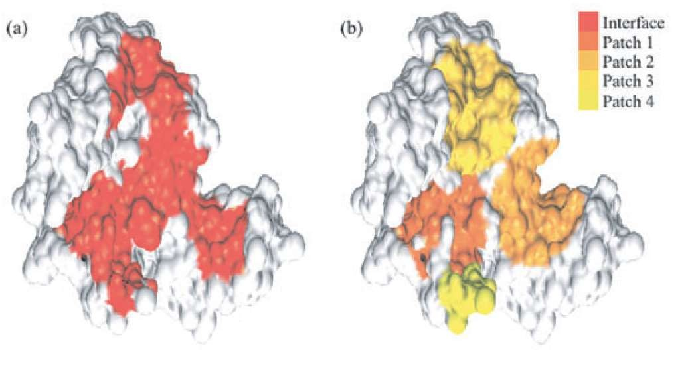
Patches and Interfaces
12

Slide 13


Properties of Protein Patches
13
Every surface vertex is labelled with 6 surface properties. They are:
Surface Shape – Two parameters called "Shape Index" and "Curvedness" are calculated.
Shape Index – Describes the shape of the local surface at any given point as is independent of the scale of the surface.
Curvedness – Is the measure of the curvature of the surface.
Conservation – The rate of evolution among amino acids. A BLAST search was performed and the resultant homologous sequences and the query sequence was aligned and the conservation score was determined.

Slide 14
14
Electrostatic Potential – It is basically the charge on the protein. For example, a DNA-binding protein has a pocket of positive charge so that it can bind with
which has negative charge from all the phosphates. The electrostatic potential of
each individual protein was computed.
Hydrophobicity - The tendency of non-polar substances to aggregate in an aqueous solution and exclude water molecules. All hydrophobic protein molecule
surfaces were determined.
Residue and Interface Propensity – The interactions of all proteins in the entire protein family is calculated.
Solvent Accessible Surface Area – The solvent accessible surface area for each atom on the protein was taken from the previously calculated studies.

Slide 15
Why Support Vector Machines?
15
 SVMs demonstrate high prediction accuracy whilst avoiding over-fitting.
 They also handle large feature spaces and condense the information given by the training dataset using support vectors.
 SVMs have also been applied to other similar molecular biology applications such as gene expression classification, protein classification, protein fold recognition, prediction of protein solvent accessibility, etc.

Slide 16

How does SVM work?
16
 Classification – Visibly separating data points in the given feature space
 Distance from example xi to the separator is
 Examples closest to the hyperplane are support vectors.
 Margin ρ of the separator is the distance between support vectors.
 It now reduces to an maximization problem, where ρ needs to be maximized
 For data-points that aren't linearly separable, we use kernel methods

Slide 17
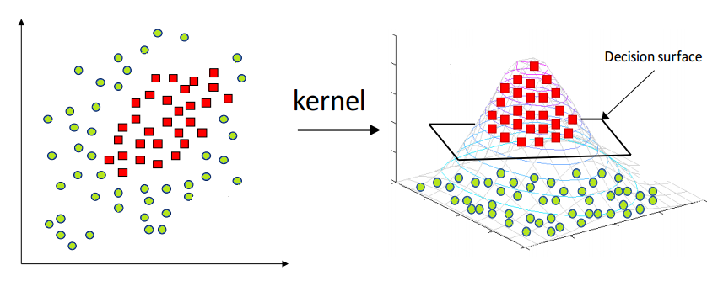
How does SVM work?
17

Slide 18
PARAMETERS OF THE EXPERIMENT
18
 Kernel: (Gaussian) Radial Basis Function
 Regularization Parameter C= 1.0
 Kernel Coefficient γ = 0.01
 Dataset of 180 patches hand annotated into interacting and non-interacting
 Varied evaluation and validation techniques

Slide 19
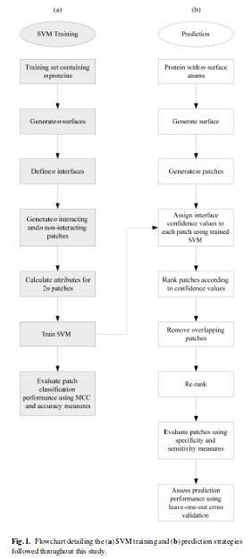
Methodology
19

Slide 20
Validation & Results
20
 Primary Validation: Leave-one-out cross validation run 5 times
 Patch Creation Evaluation:
Specificity: number of interface residues in patch/number of patch residues
Sensitivity: number of interface residues in patch/number of interface residues
Success if a patch with over 50% specificity and 20% sensitivity was ranked in the top three
 Able to predict the location of the interface on 76% (136/180) of the proteins in dataset. In 60% (81/136) of these instances, a patch with over 50% specificity and 20% sensitivity was the top ranked patch
 P-value significance tests were used to prove that this method performed atleast twice as better as random sampling

Slide 21
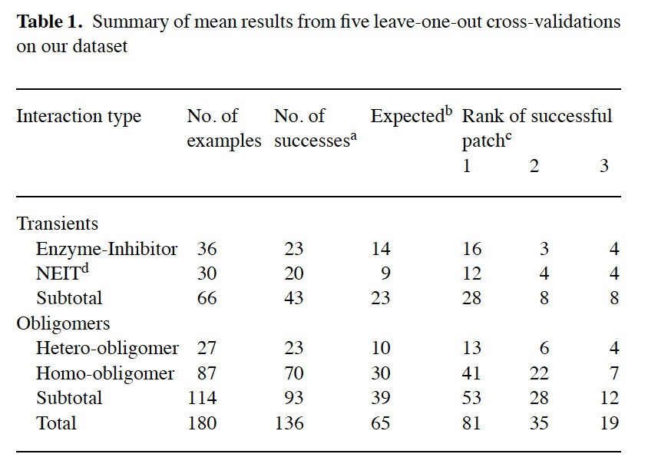
Validation & Results
21

Slide 22
Validation & Results
22
 Other Dataset:
 Jones and Thornton achieved a success rate of 64% (30/47) with their path analysis tool
 Our method achieved 72% (34/47) on the same dataset
 Secondary Heterogeneous Cross-validation: training the SVM on the proteins involved in obligate interactions and predicting on the transient (enzyme- inhibitor and NEIT) complex types and vice versa gave a success rate of 64% [42/66; Table 2] and on obligate interfaces based on training with transients with a success rate of 83% [95/114;Table 2]

Slide 23
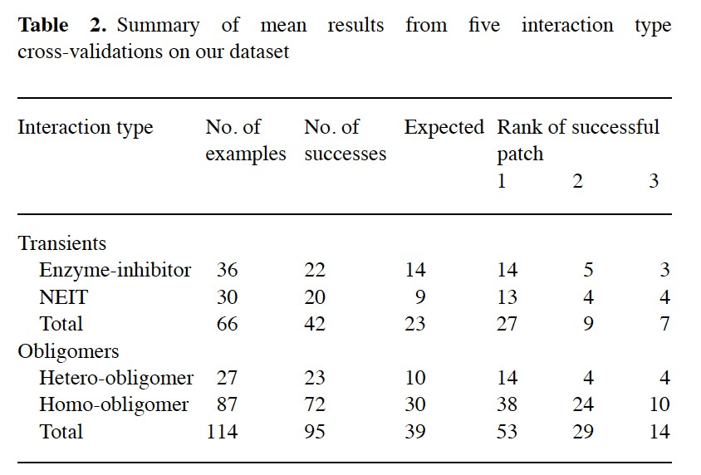
Validation & Results
23

Slide 24
Validation & Results
24
 Unbound Proteins: Select 10 unbound proteins that have >70% sequence identity within the dataset
 All nine of these predictions reached >50% sensitivity, which suggested that our patch sizes, calculated as 6% of the whole protein surface are were an accurate estimate of interface size
 No patch was ranked below two and five were ranked first

Slide 25
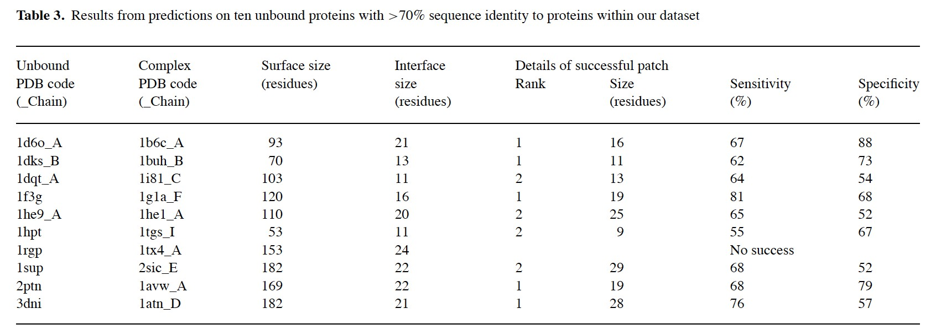
Validation & Results
25

Slide 26
Validation & Results
26
 Unbound Proteins: Select 10 unbound proteins that have >70% sequence identity within the dataset
 All nine of these predictions reached >50% sensitivity, which suggested that our patch sizes, calculated as 6% of the whole protein surface are were an accurate estimate of interface size
 No patch was ranked below two and five were ranked first
 CAPRI (Critical Assessment of PRediction of Interactions): A significant prediction of the interface was made in 11 of the 15 cases where the P-value for random predictions was <0.25

Slide 27
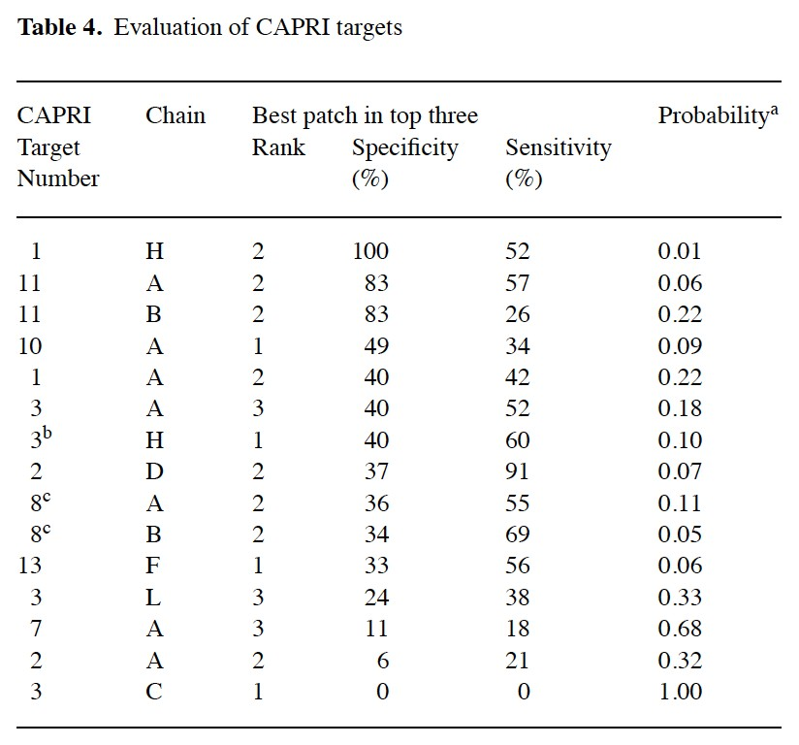
Validation & Results
27

Slide 28
References
28
https://www.researchgate.net/publication/221586641_Prediction_of_Protein-Protein_
Interaction_Sites_Using_Support_Vector_Machines
https://en.wikipedia.org/wiki/Support_vector_machine
Computational Intelligence Methods for Bioinformatics and Biostatistics: 8th Edition by Elia Biganzoli, Alfredo Vellido, Federico Ambrogi, Roberto Tagliaferri

Slide 29
Questions?
29

Slide 30
THANK YOU!!
30

